Slide 1


ROAD TRAFFIC ACCIDENTS DETECTION BASED ON CRASH ESTIMATION
Authors
Khaled Sabry Mohamed Emad
Department Of Computer Engineering, Cairo University, Egypt
Conference: 2021 17th International Computer Engineering Conference (ICENCO)
Notes:
hey.. Hey everyone, My name is khaled sabry and I am here to show and illustrate what me and my friend Mohamed Emad have been working on in the research paper (Road traffic accidents detection based on crash estimation)

Slide 2
Problem ?
Notes:
but before we dive into that
we need to ask one question.. What do we want to solve here ??

Slide 3
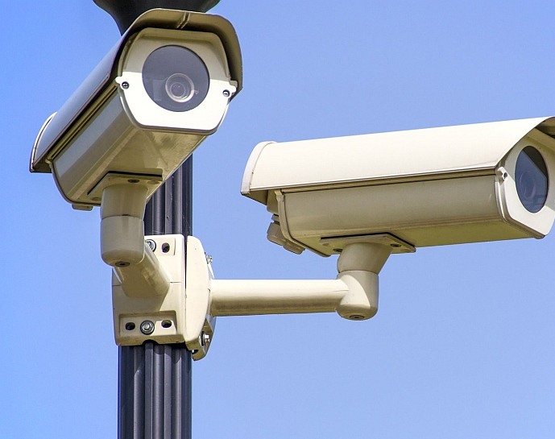
Detect road accidents using CCTV cameras
Notes:
we want to detect vehicle accidents by using CCTV cameras that are installed on the roads.
But why??... why is that ?? Because people's lives matter.. and officials say that if we could shorten the time between the occurrence of the accident and the first report on it then we will be able to save some of injured lives.

Slide 4
Why Now?
Notes:
But why now?? why at this time?? .. from my opinion because of three points

Slide 5
Why at this time ?
Enough processing power
Enough CCTV cameras
Reliable, robust and accurate system
Notes:
first.. we now have the technology.. we now have enough processing power to process this enormous amount of data and the second point is.. we now have so many CCTV cameras already installed on the roads…
for example.. in China they have 500 million cameras. and the third point is… we now have a system… we now have a reliable, robust and an accurate system.
So let's take a quick look at the recent work in this area..

Slide 6
Different Approaches
Deep Learning
Feature Extraction
Notes:
the work done for this problem was in two directions One, is using deep Learning approach two is using Features extraction - So we have investigated the deep learning approach
- but the results of this approach were actually so bad… as this is hard problem to be solved in current days using deep learning
- why is that ??

Slide 7

Deep Learning approach Cons
No sufficient data
Accidents are stochastic
Notes:
- because there is No sufficient data for accidents
- and the Accidents itself are stochastic so you need very and very large dataset before you propose a system to be reliable So we went for the feature extraction approach

Slide 8
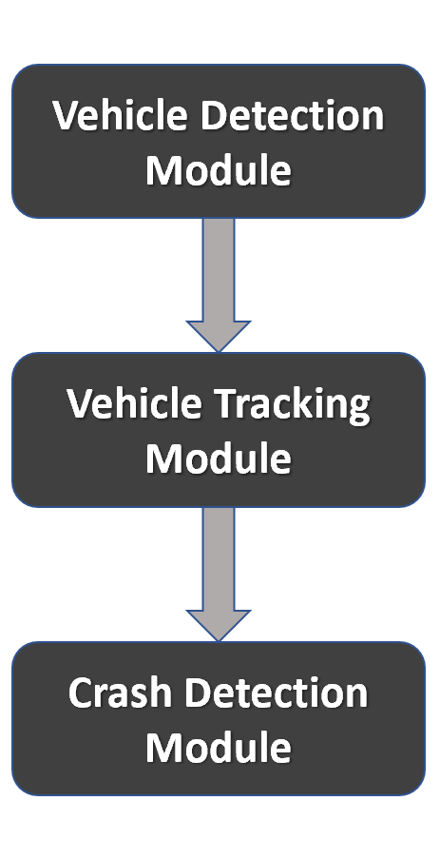
Feature Extraction Approach
Notes:
and many research papers suggested a framework for accident detection
which start with the detection module
which detects vehicles on the frames then goes to the tracking module to track these vehicles and lastly the crash detection module which for example one prominent work have used violent flow descriptor
which really had good true alarms but huge false alarms that made the system unreliable ,
so we started working on how to decrease these false alarms until we found another algorithms to detect the crash which we name it crash estimation module

Slide 9
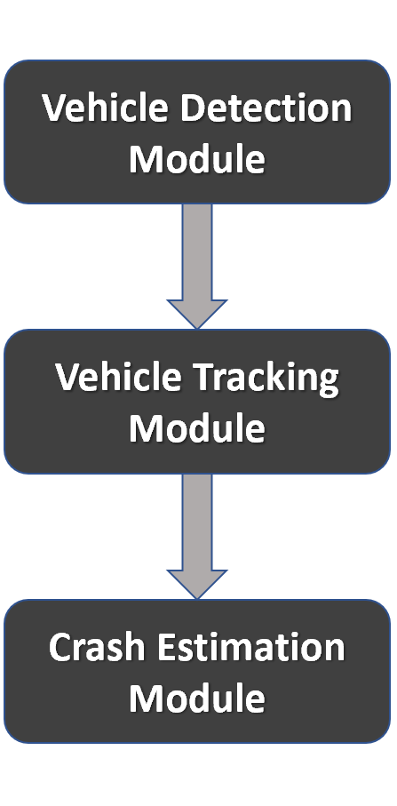
Final Framework
Notes:
So our final framework is that
Detection then tracking and end with crash estimation

Slide 10

Detection Module
Yolo (You only look once) state of the art object detection system
Notes:
In detection module we used a famous deep neural network called Yolo, it's fast and accurate in detection. Input to this module is (1 second and the 1 second contains 30 frames)
we only process in yolo the first frame and send the rest to the tracking module

Slide 11
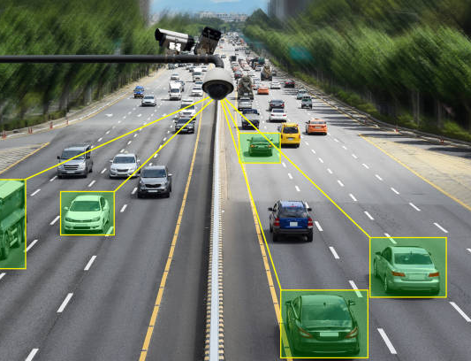
Tracking Module
Lucas Kanade tracker
MOSSE (Minimum Output Sum of Squared Error) tracker
Notes:
the Tracking Module
In this module we tried two algorithms for tracking one of which was Lucas Kanade tracker
it was slow and results in bad tracking as it depends on corners of the vehicles as features to track which when an occlusion occurs it loses its focus
So we went to another tracking algorithm called Mosse which is fast and accurate and better in occlusions and rotations The Input to this module is the output of the detection module which is 1 with the detected vehicles and 29 frames to track every vehicle in them The output of this module consists of an Object for every vehicle storing the positions in a pixel unit and sending only the objects to the next module.

Slide 12
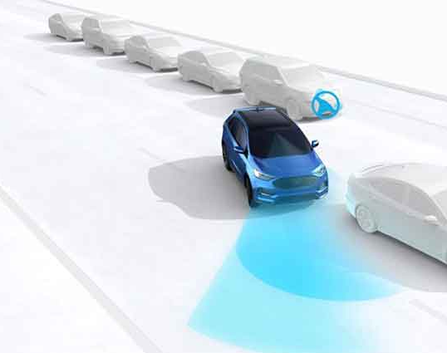
Crash Estimation
Measure average speed.
Measure estimated future position.
Compare the average speed of each two vehicles with each other.
Measure the distance between the estimated future centers of the two vehicles.
Compare the estimated future position to the actual position.
Notes:
Now… let's dive into our work.. the algorithms to detect the crash..
I found it is better to list the whole steps at the start and go in depth later
so first.. we need to estimate the speed of the vehicles
second.. estimate the future position for the vehicles
and third algorithm… compare the average speed for each two vehicles at specific frame No…
and fourth algorithm.. is we need to measure the distance between the estimated future centers
and lastly.. compare the estimated future center to the actual future center

Slide 13
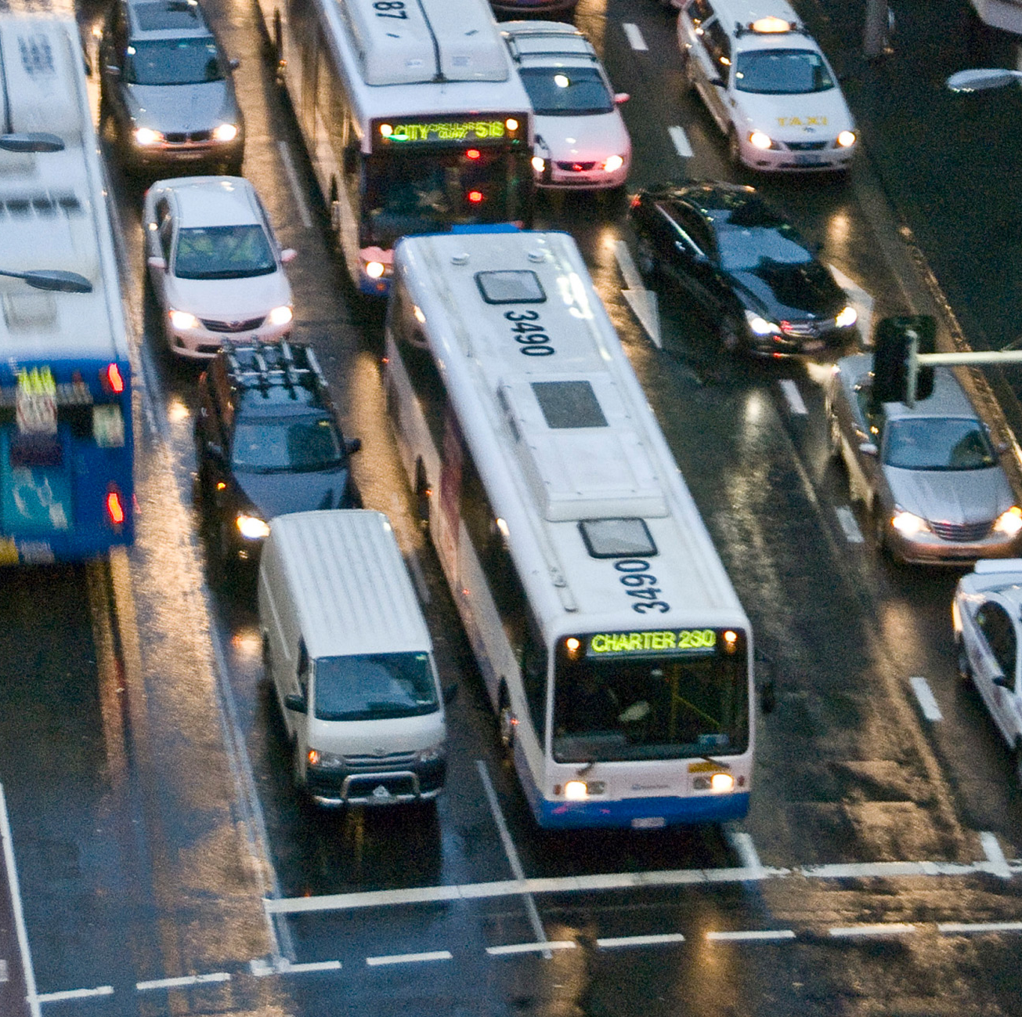
Measure average speed
Notes:
So let's start with the first algorithm… the speed estimation
we need first to estimate the speed of the vehicles, but it is not a trivial process as it might sound, as we deal with generic CCTv cameras that have different resolutions and capture the view with different scale or hanged in different angles, that is why we must measure the speed with different unit other than the pixel unit So we have two problems here when we try to estimate the speed

Slide 14
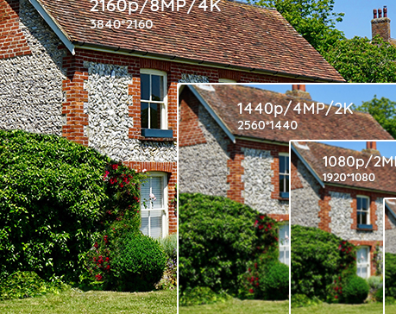
Camera Resolution Problem
Notes:
the first… is the camera resolution, as we may have some cameras with hd quality and others with full or ultra hd resolution
to solve this, you need to downscale or upscale your input to the system with static resolution.

Slide 15
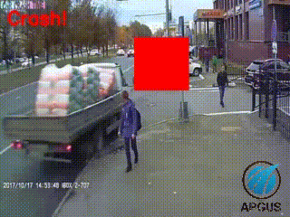
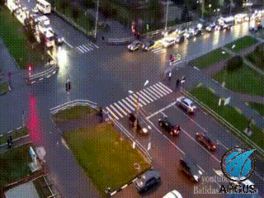
Camera Shot Problem
Closeup Shot
Long Shot
Notes:
the second problem… is the camera shot scale, .. if the camera shot is close to the street then it will show that the vehicles are moving faster than the vehicles that are captured by a camera taking a wide or long shot,

Slide 16
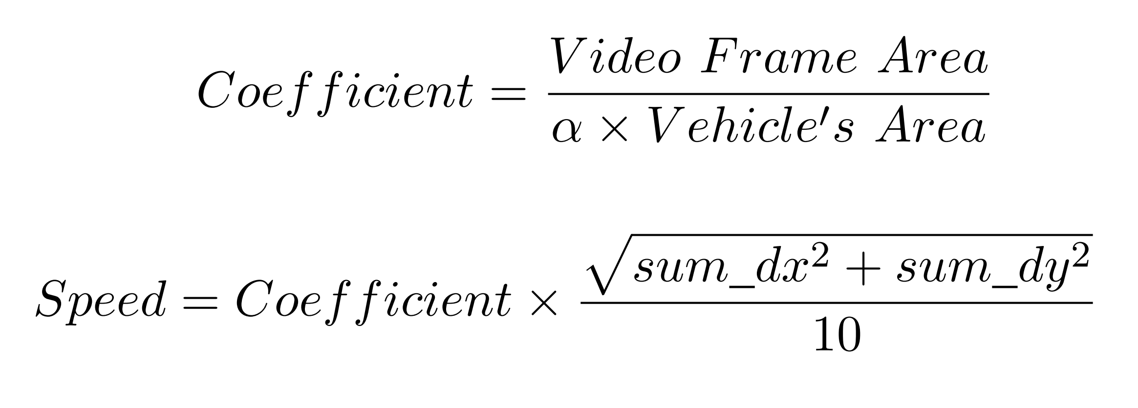
Speed estimation solution
Alpha symbol value is different with different vehicle’s type.
Video Frame area should be fixed from the start but if you do not want to fix to one resolution then the coefficient will solve it.
Vehicle’s Area is depending on the pixel unit area of the shown vehicle.
sum_dx represents the moving distance in horizontal direction in the last 10 frames.
Notes:
So we applied these two equations to solve this problem. as you can see we multiply the speed by a coffienct to change the speed unit from pixel unit to scaled unit… so here in the coffienct you can see that whenever the vehicle area increases which means that the camera is taking a close shot then the speed will be slower but also we are taking into consideration the
different types of vehicles as the motorcycle area will appear less than truck area at all cases… which is handled by the alpha symbol.. a hyper parameter that is set different to each type of vehicle.. you can also see from the equation that we handled the different types of resolutions… The estimated speed from this equation was very good, especially to our problem here.. so let's go to the second algorithm… The estimated future center

Slide 17
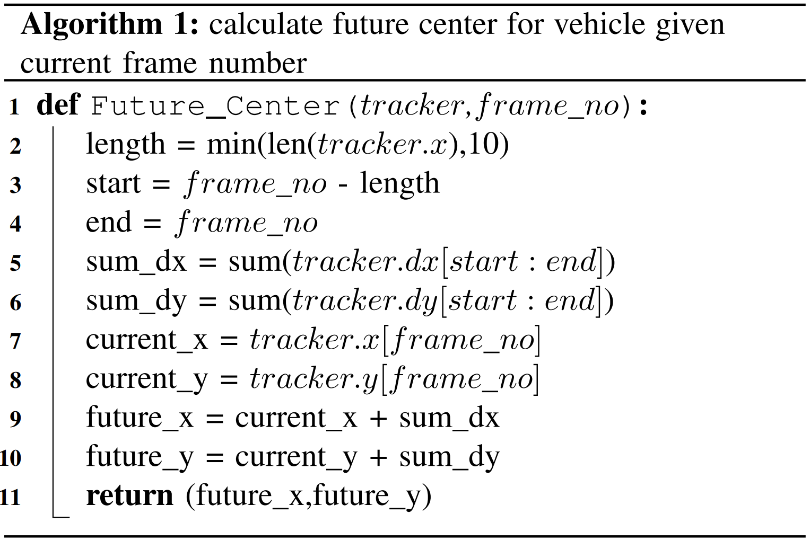
Measure estimated future position
Notes:
we now have the exact positions for 30 frames, we need to estimate the future center after 10 frames. let's take an example, if the vehicle is in frame No 11 we need to know where it will be after 10 frames from now which means where the estimated future center is at frame No 21.
and solution for that is simple at this point, as we will get the average of the past 10 frames in x axis and y axis and will estimate where it will be
you will notice that the array of estimated positions must have the first 15 positions with value equals zero and that is because we can not estimate where the vehicle will be in frame No 11 with only one frame.. so to solve this… the system will need to detect vehicles every half second and send 30 frames as usual to the tracking with no change in the next modules. from Now on the next algorithms you will have to implement them in order… but first we will need to define an important thing

Slide 18
CASE ?
vehicle A with vehicle B at frame no X
Notes:
we will not investigate in images or footages we will investigate in case, so what is a case A case is Vehicle A with Vehicle B at frame No x
so we will compare every two vehicles with each other and every two vehicles we will compare them at specific frame No and either to tell this is accident or Not

Slide 19
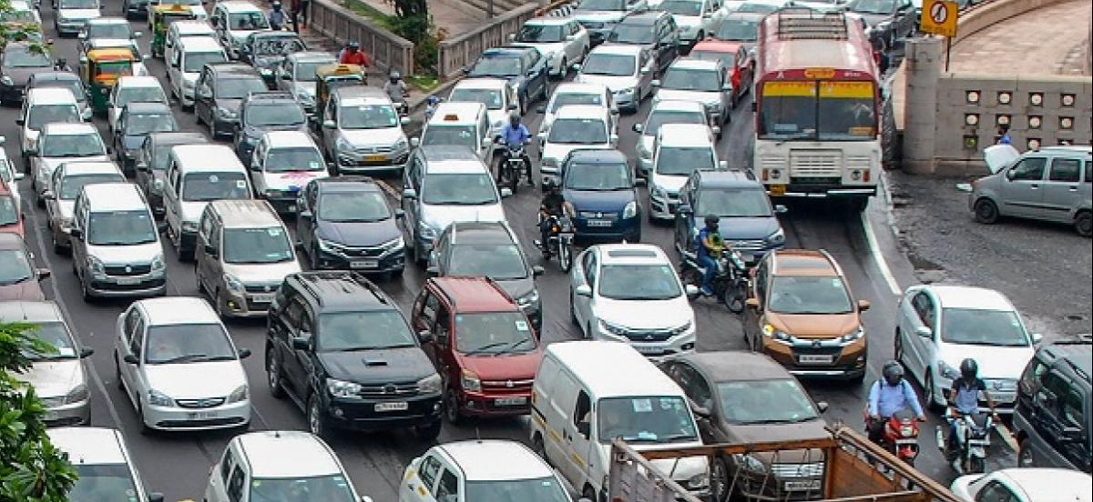
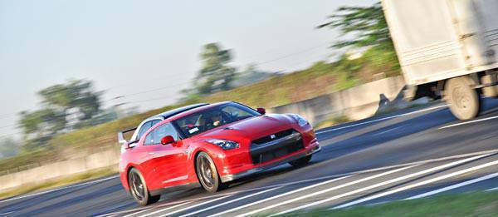
Compare the average speed of each two vehicles with each other
Notes:
so let's start with the third algorithm.. comparing average speed of each two vehicles In this step we need to limit cases that could cause an accident by the speed..
So.. if both vehicles are moving slowly or stopped then we will limit this case as it won't make an accident as their speed wouldn't allow them to do so..
But.. if one or both of them are moving above the speed limit then it could cause an accident to each other so it will go to the fourth algorithm.. After this module.. Only high speed cases will be investigated
This module helps a lot in improving performance… As you can see in the photo in a traffic jam the system will limit those possibilities of a crash at this step and will not go further.

Slide 20
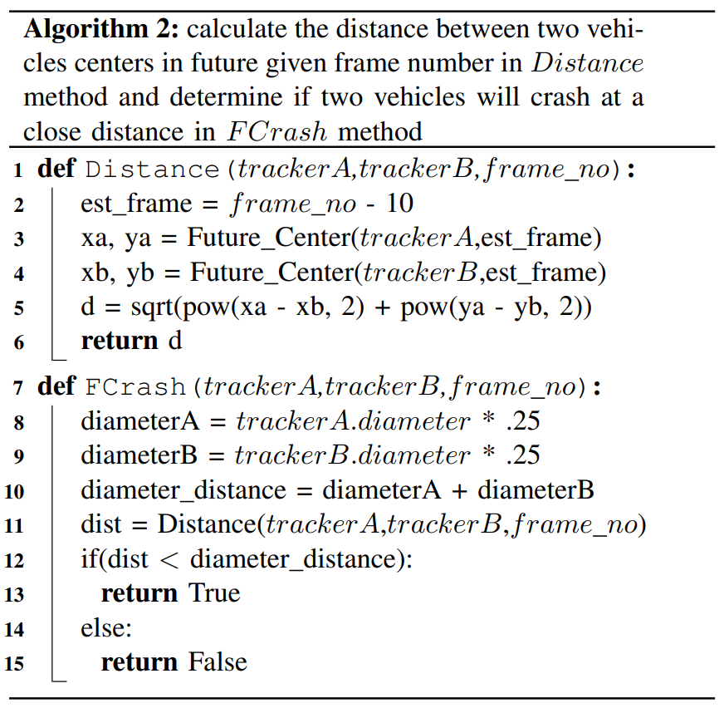
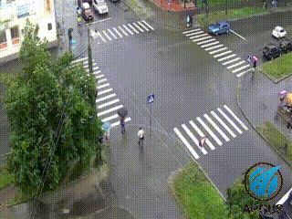
Measure the distance between the estimated future centers of the two vehicles
Notes:
the fourth algorithm.. Measuring the distance between the estimated future center why do we need that ?? as we need to limit the cases where the vehicles will not meet close to each other in the future… but why did we use the estimated future ?? Why didn't we use the current positions ?? The answer is.. the two vehicles may be at the current position away from each other but with the high speed of the two, the estimate after 10 frames will be close to each other and it may cause a crash. So according to this algorithm in the photo you can calculate the limit value by the two vehicles diameters if it's below then a crash may occur.. and if not then they will be away from each other in the future
After this module.. Only high speed and close to each other cases will be investigated

Slide 21
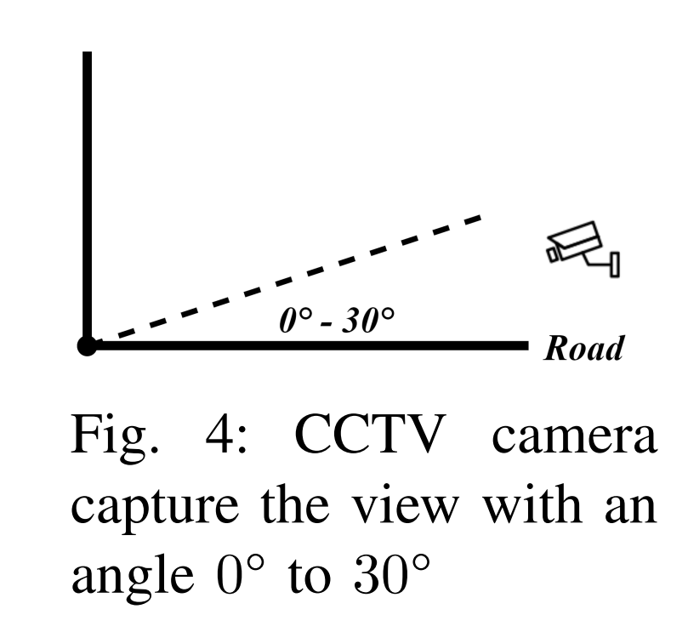
Compare the estimated future position to the actual position
Notes:
the fifth and last algorithm..Compare the distance of future and actual center at this stage or at this point High speed vehicles and close range to each other will report on an accident but if the camera angle is not perpendicular on the road which is most of cctv cameras are… then an occlusion will occur and it will show as if they crash to each other

Slide 22
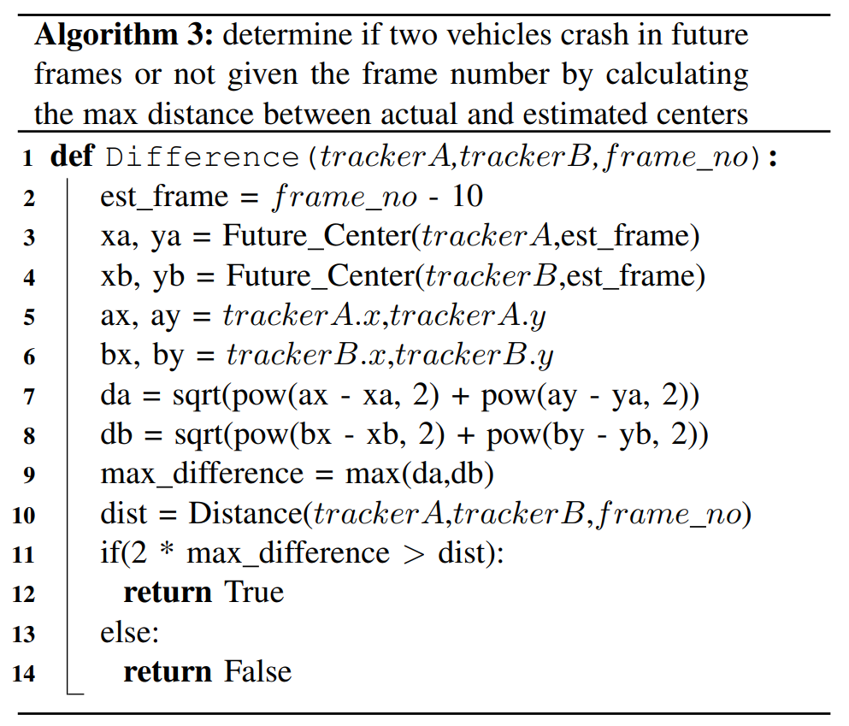
The biggest Error
Notes:
To solve this..we will calculate the difference between the estimated future and actual position for each vehicle in a specific case.. and as we investigate in a case we will take the biggest difference which will refer to the biggest error from the two vehicles…
if the biggest error is bigger than half the distance of the estimated future center for both vehicles then it's a crash if below then it's not a crash.. take a second and look that we have used the estimated future center and not using the actual center at this frame and that is because the actual center if an accident occurs will be wrong as the estimated future will get us results before an accident occurs
at this point we can say all the cases that reach after the last algorithm are accidents and report on them… but we also thought of another module to add which is called crash detection and using as we said earlier an algorithm called violent flow descriptor which introduced in a research paper called "Real Time Violence Detection in Video" and used from the same authors in a research paper for accident detection called "Fast car Crash Detection in Video" we said earlier that this algorithm results in good true alarms but has huge false alarms that made the system unreliable to use… so after adding our module crash estimation we limited these huge false alarms and send to violent flow descriptor true alarms with very few false alarms.. I will talk about the comparison later but Now let's talk about performance improvements

Slide 23
Performance Improvement
Use TCFI (track compensated frame interpolation) in tracking module
01
Make pipeline and separate the modules to processes
02
Order the algorithms as specified in the research paper
03
Notes:
So..
first point.. in the tracking module.. we modified the algorithm a little bit to work with our problem efficiently.. so we introduced an algorithm called track compensated frame interpolation.. which you won't need to track a vehicle for each frame especially if it is stopped or moving slowly in a congested roads and for that estimate the frames where it will be … and for the sake of this presentation time I can't cover it here but I wrote in detail in the research paper as this helped to increase the tracking module performance to double especially in congested roads. Second point.. separate the detection module to its own process.. as the detection depends on GPU so at this point the CPU will stay idle so it's better to work on other modules and not wait for the results of detection. third point… order the last three algorithms as specified in this presentation or the research paper as we start first by limiting the high speed cases.. then close to each other cases then cases where a vehicle partially covers another vehicle so if you applied these algorithms out of order it will decrease the performance by a lot.

Slide 24
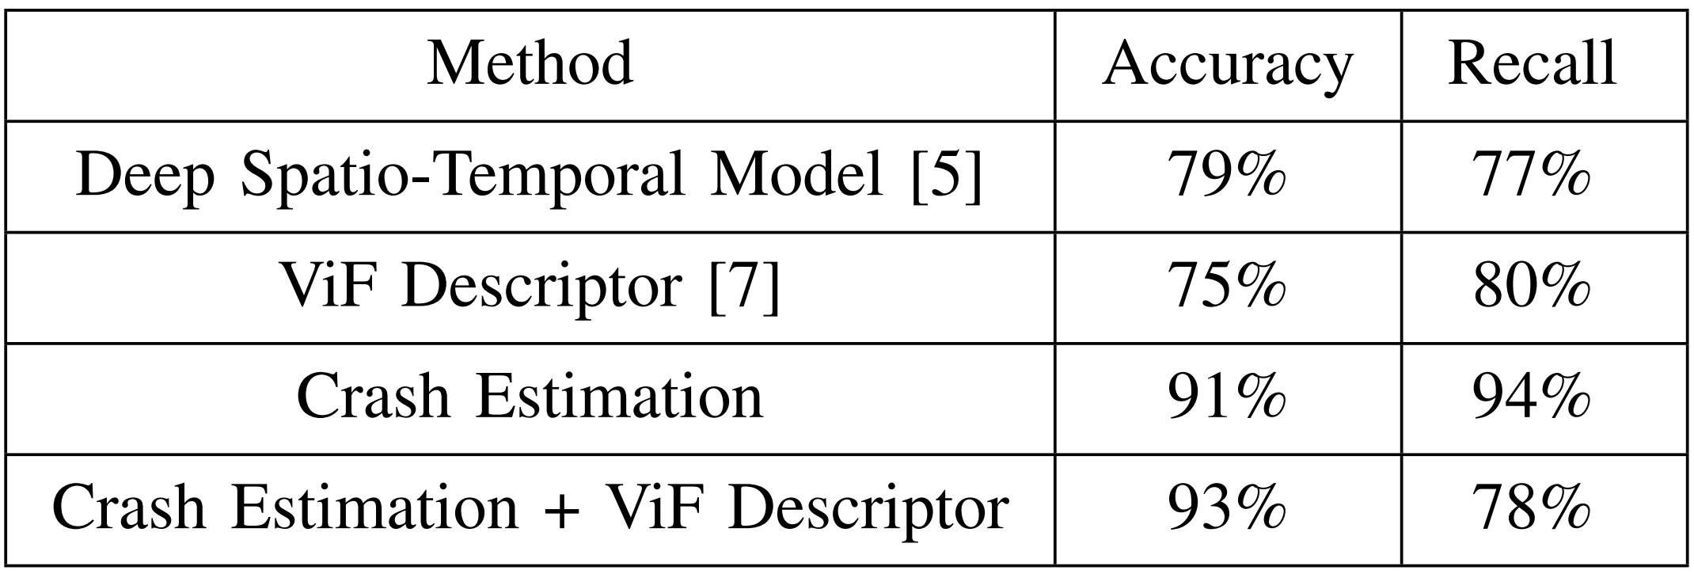
Accuracy
Notes:
Now it's the time to compare our framework to others
from accuracy point of view our framework beats all previous works by a big margin… we had slightly better accuracy from crash estimation plus violent flow descriptor than crash estimation only but the recall percentage is much different.

Slide 25
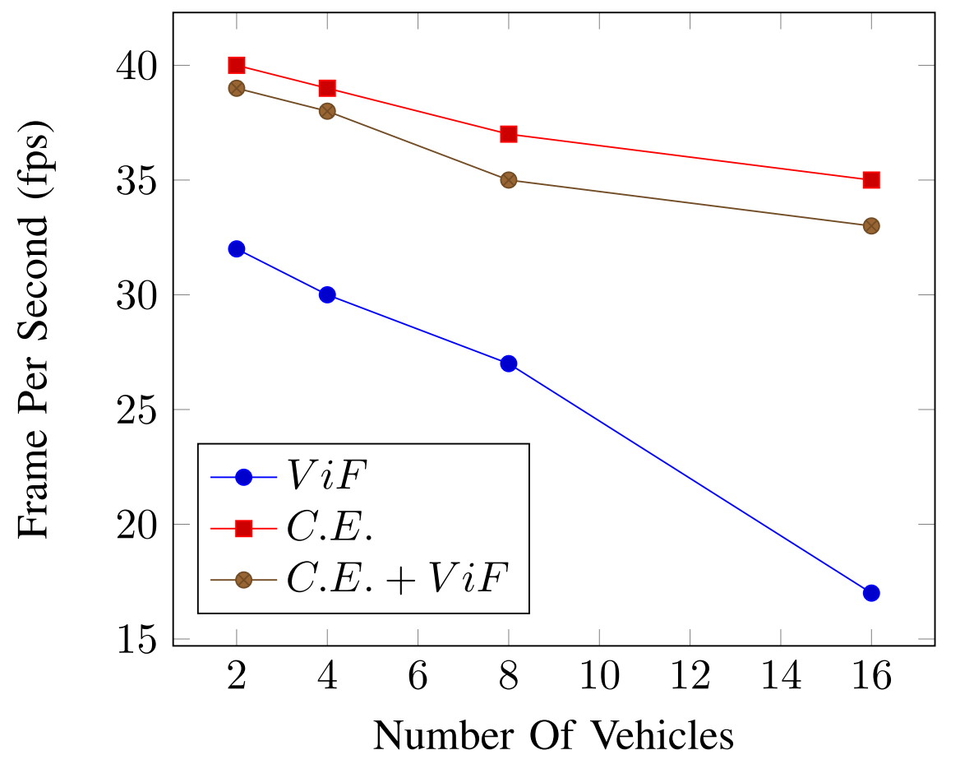
Performance
Notes:
from performance point of view we were able only to test three frameworks
violent flow descriptor only and crash estimation only and both of them
the worst was the violent flow descriptor only because it doesn't filter any footages and process them all, the best performance was the crash estimation only we were able to achieve real time performance on our normal laptops

Slide 26
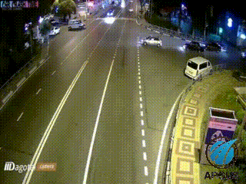
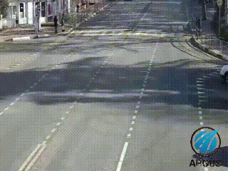
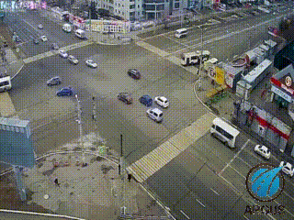
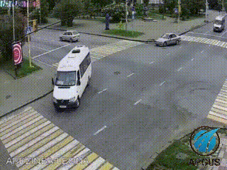
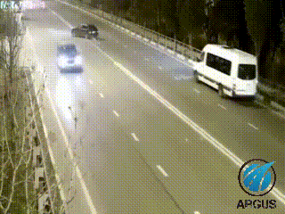
The Project
https://github.com/khaledsabry97/Argus
Notes:
Lastly.. I need you to take a quick look at the project itself. You can see some outputs and test by yourself.. we provided also an easy way to run test videos without using yolo or gpu
you can also see the dataset we have collected from youtube compilation videos and also you can see the output of the system from different types of accidents… you can go and download the project from this link… and before I go.. I want to thank the conference committee for allowing me to show the work that I and my friend made.. I also want to thank my professor Nevin Darawish for her support and I want to thank you all for listening…. thank you

